Slide 1
Special topics Session 1 Al-Zahra university Maryam zim

Slide 2
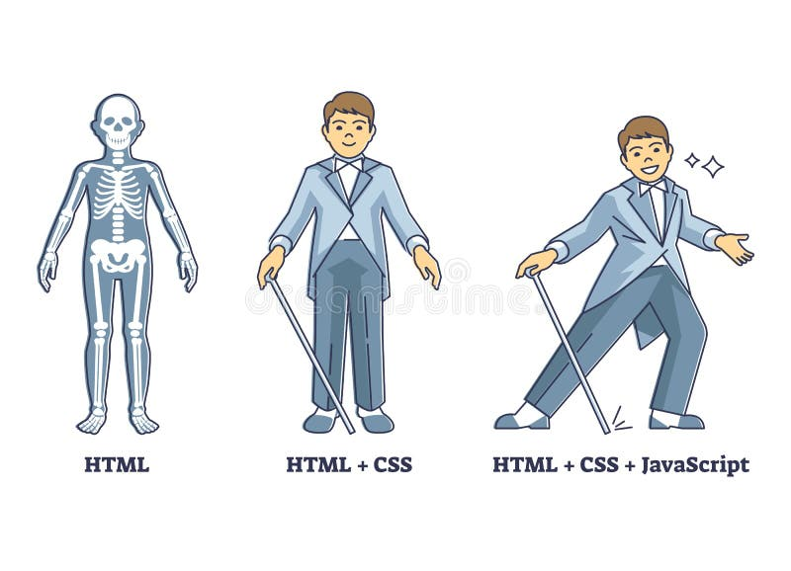
What is HTML ?
Html is Hyper text mark up language.
It is the standard markup language used to create the structure of the every web page.
Actually :
Hyper text refers to the linking capability of html that allowing you to connect one page to another through hyperlink.
This is what enable you to navigate by clicking on links .
Markup language means it uses tags and elements to display conten
Imagine a web page like the Human Body
and HTML, CSS & JS are
Bones and styles and behavior.

Slide 3
When you open a web page , what do you think behind it ?
When you want to create a html page you should use .html as an extension .
The basic structure an html document includes an <html> tag that wraps everything.
A <head> section for metadata and a <body > section that contains all the visible content.
<!Doctype html>
It’s declaration, not on html tag . It tells the web browser “This document is written in html 5 “
It must placed at the top of every Html document before <html> tag.
Without it , the browsers switch to quirks mode (older rendering rules) which can cases pages to look wrong.

Slide 4
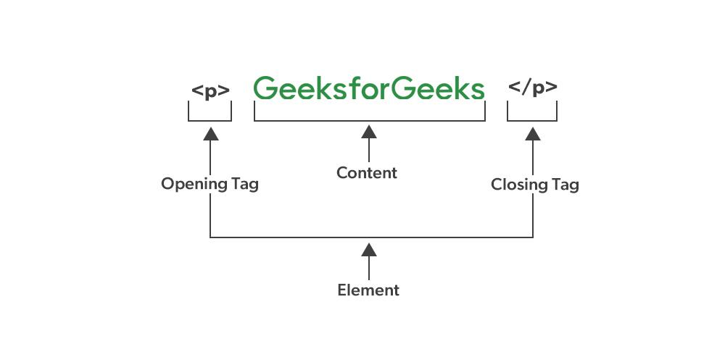
Tags :
A tag is a piece of code inside angel brackets <> that tells browser how to treat content.
Tags usually comes in pairs : <opening tag> and </closing tag>
Tip : Some tags are self closing and no content inside it. Like <img /> tag.
Element :
An Element is complete structure including :
<opening tag > content < /closing tag>
Like : <div> content </div>

Slide 5
Parts of Html Document :
It’s contains :
1- html tags : <html > </html>
It’s a root and outermost the container for the whole page.
Everything except the Doctype.
2-head tag <head> </head>
Contains metada or information about the page.
This is stuff that isn’t visible on the web page itself but is crucial for the browser and search engine.
It’s consist of:
Titl
Metadata
Link
Script
Title:
element defines the title of the document. The title must be text-only, and it is shown in the browser's title bar or in the page's tab.
Metadata :
Metadata is data(Information) about data. Metadata is written inside <head> tag in html .
Metadata is Information that describes the web page. It usually doesn’t appear directly on the page but browser , search engines and
Social networks use it
General syntax : <meta name=“” content=“” />

Slide 6
Common meta tags :
<meta charset=“UTF-8” />
There is a standard encoding system that can display
all the letters and symbols of different languages ​​in the world, including Persian, Chinese, etc.
<meta name=“description” content=“This is my first page” />
Define a description of your web page.
<meta name=“author” content=“Maryam zim” />
Show how wrote the page .
Before we move on to viewport meta, we need to know
what is viewport ?
The viewport is the user's visible area of a web page.
The viewport varies with the device, and will be smaller on a mobile phone than on a computer screen.

Slide 7
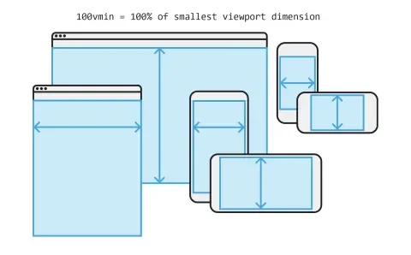
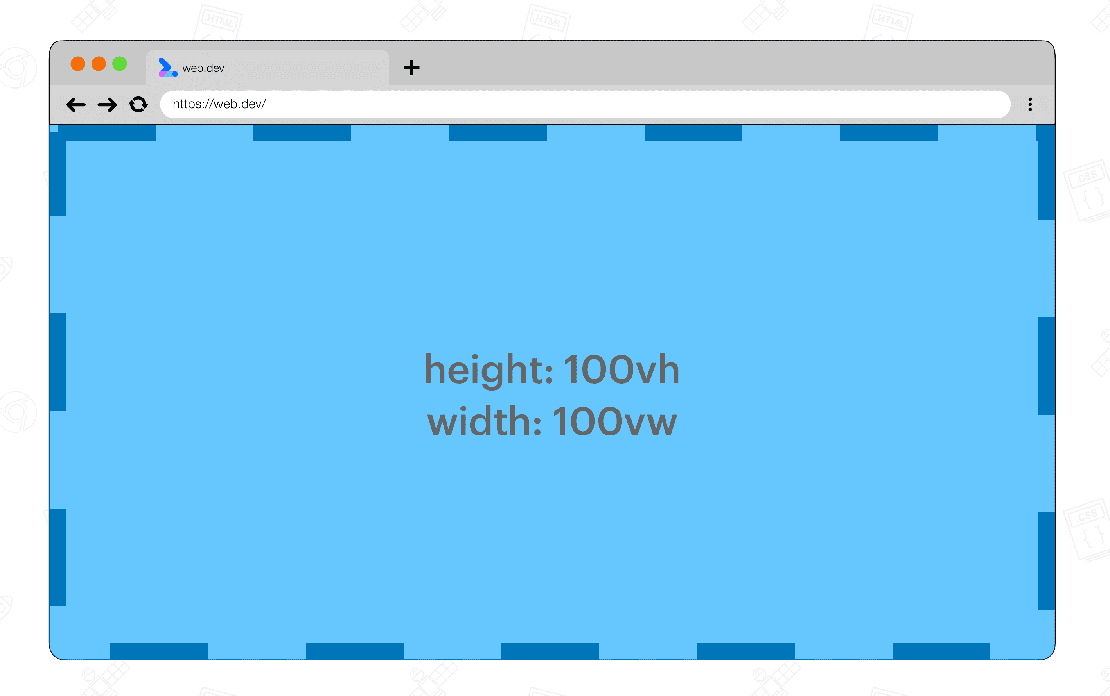
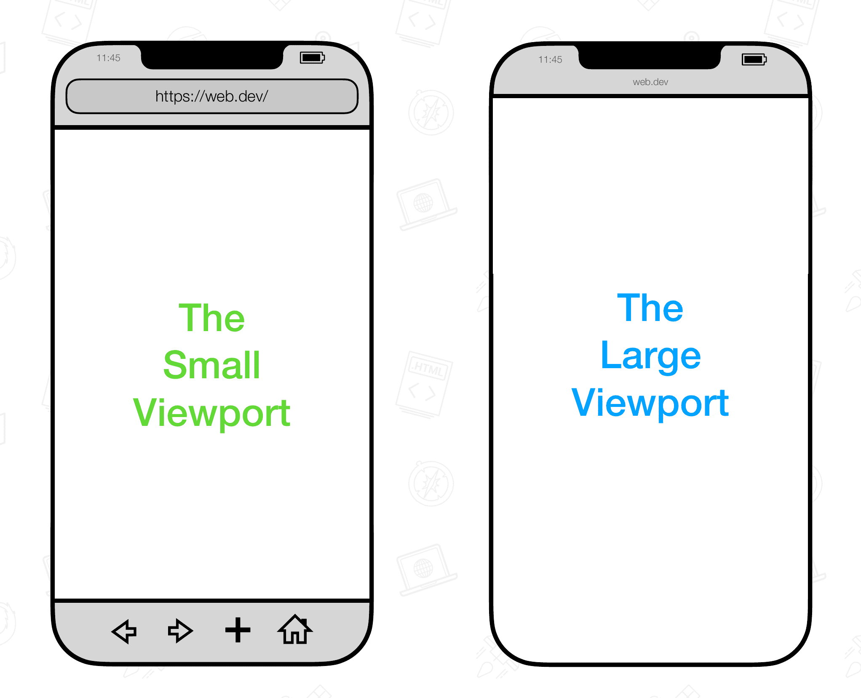
There are types of view port:

Slide 8
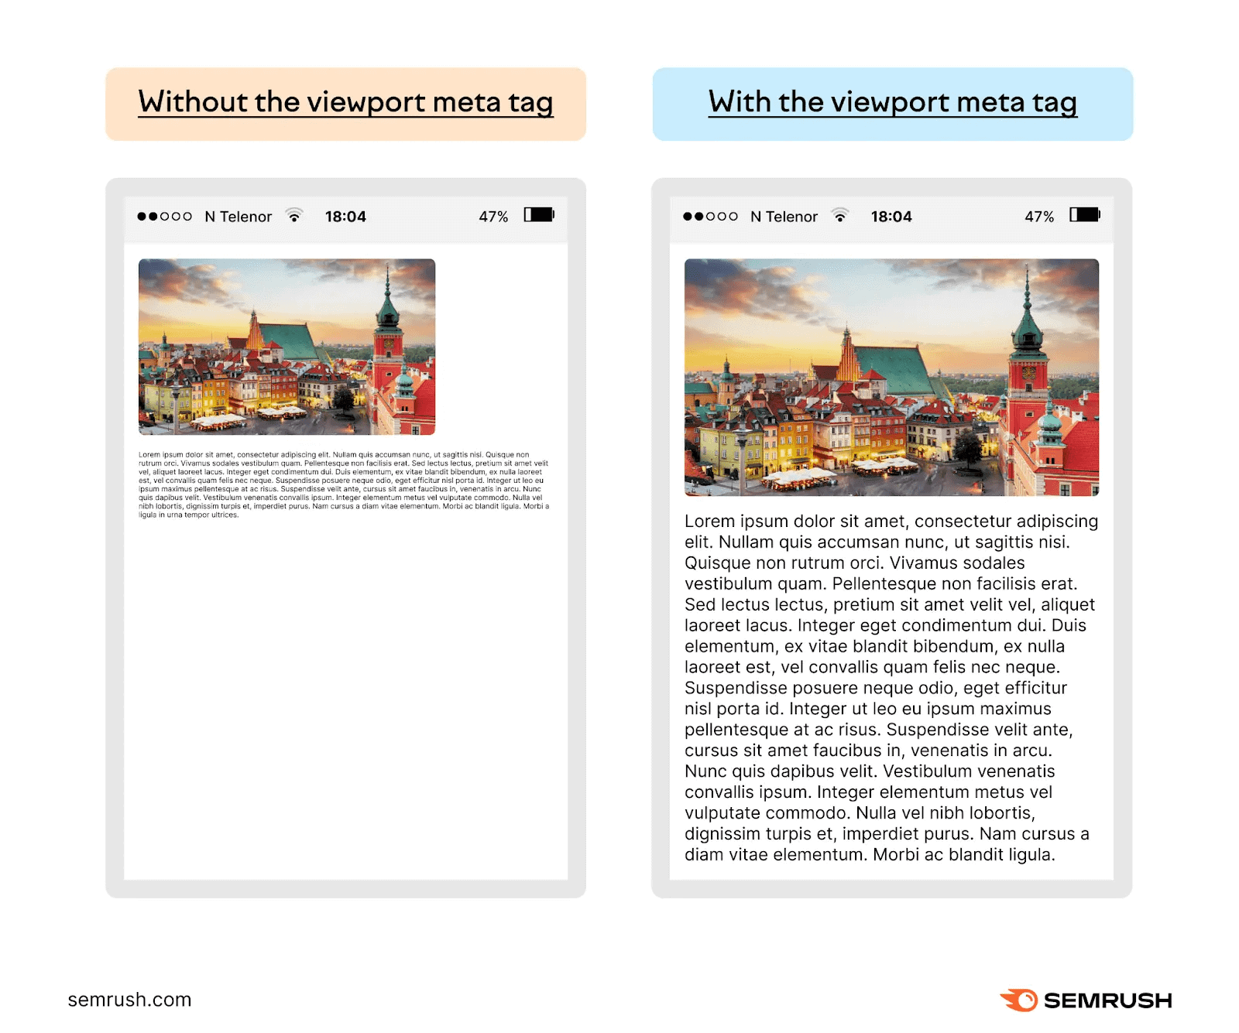
<meta name=“viewport” content=“width=device-width, initial-scale=“1.0” />
It is an important tag that tells browser how to display web page in difference device.
Width=device-width means Set the screen width to match the device the user is using.
Initial-scale = 1.0 means There should be no initial zoom when the page is first opened.

Slide 9
<link> tags:
Loads for files like css file and icon.
<link rel=“stylesheet” href=“style.css” />
<link rel=“icon” href=“favicon.ico” />
<script> tag :
It’s for Loads java script file.
We use defer or async attribute in closing tag.
What is difference between async and defer in script ?
Both are used to improve loading speed because they allow the browser to download the script file at the same time as loading the HTML, but the main difference is in the execution time of the script.
async — Loads in parallel and executes as soon as it arrives (best for independent scripts like analytics).
Defer - Loads JS in parallel, executes after HTML parsed (great default).

Slide 10
<Body > tag :
Everything the users see and interact is in this tag.
What is attribute :
Attributes give extra information about html elements.
We should written inside the opening tag only.
Format = > <tag-name attribute-name=“value > content </tag-name>
We have 2 types :
1- global attribute => works on most element like id/class/style , etc
2- element specific => required for accessibility :
For example:
<img src alt />
Src = path of image
Alt= The alt attribute provides alternative information for an image if a user for
some reason cannot view it (because of slow connection,
an error in the src attribute, or if the user uses a screen reader).
Tip: To create a tooltip for an image, use the title attribute!

Slide 11
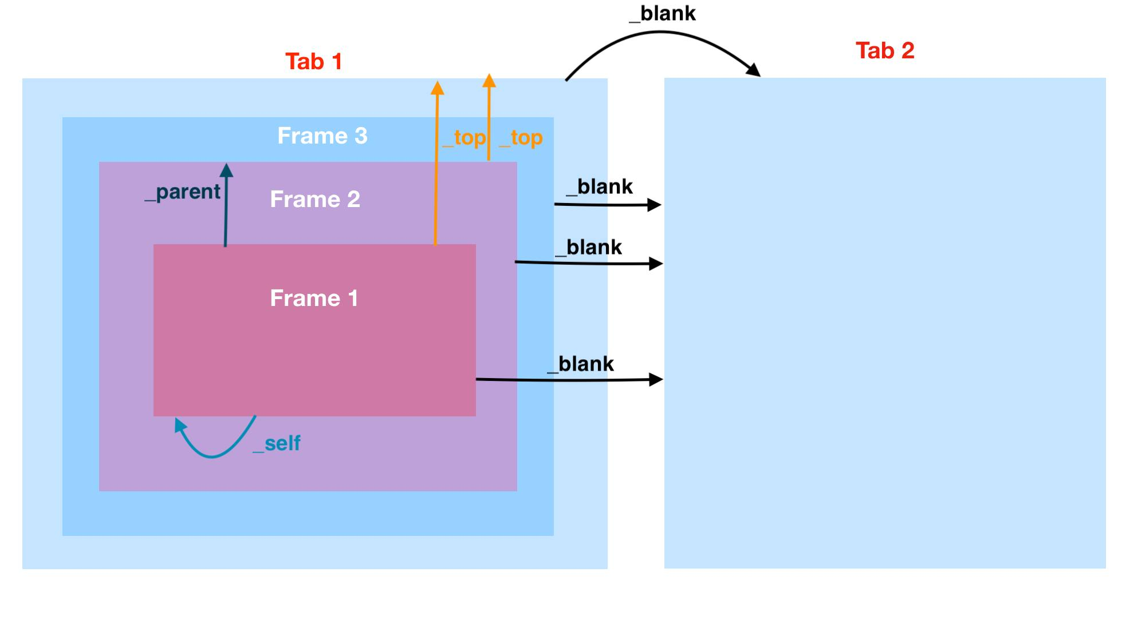
<a href target >
Href = The href attribute specifies the URL of the page the link goes to.
Target = The target attribute specifies where to open the linked document:
_blank | Opens the linked document in a new window or tab
_self | Opens the linked document in the same frame as it was clicked (this is default)
_parent | Opens the linked document in the parent frame
_top | Opens the linked document in the full body of the window

Slide 12
Water fall :
Browser read the html top to bottom.
This is called document flow.
Nesting :
Placing one element inside another elements.
Rules nesting :
1- only opening tag must have closing tag
2- child elements go inside parent elements.
3- nesting must be logical and valid.
<p>
<div> </div>
</p>
This is wrong!

Slide 13
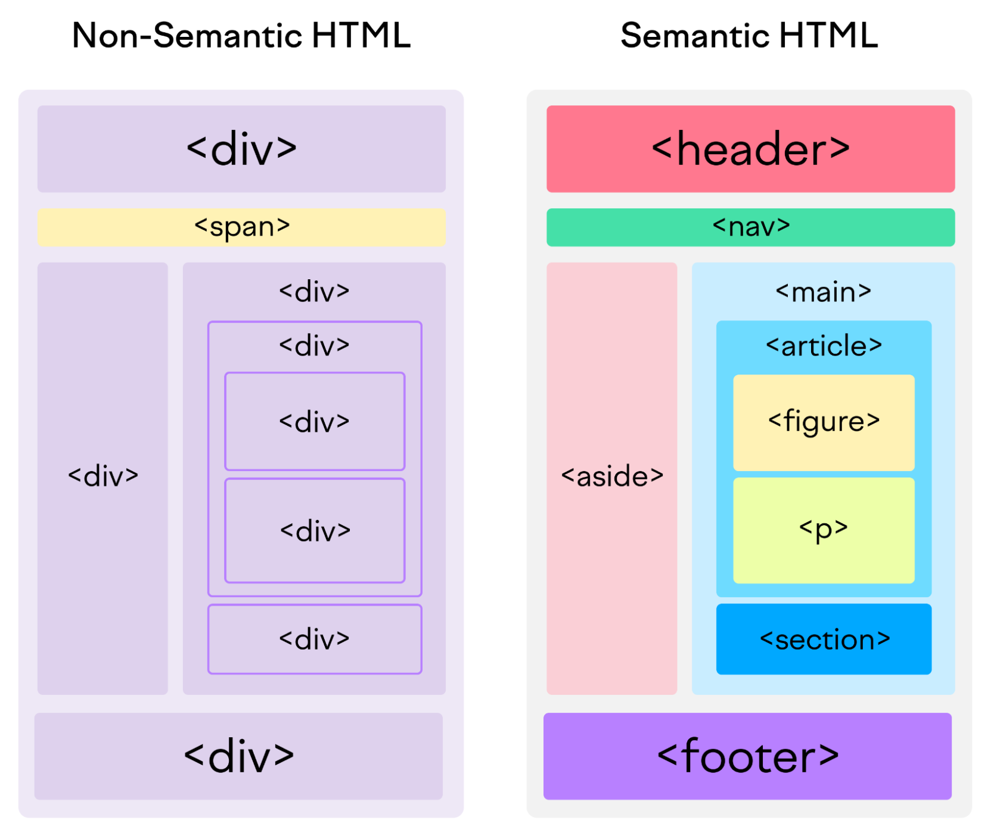
Semantic tag:
Semantic tags are html tags that have a clear prop.
They tell both the browser and developer what kind of content is inside.
We have 2 types :
1- structural => header / nav / main / article / aside / footer /section
2- text-related => h1..h6 / p / figcaption / time / mark/ address / cite
Why semantic tags matter ?
1- accessibility : screen readers can navigate properly.
2- SEO : search engines understand structure better
3- maintainability: other developers can understand your code easily

